Slide 1
Module-2
From Understanding to Preparation

Slide 2
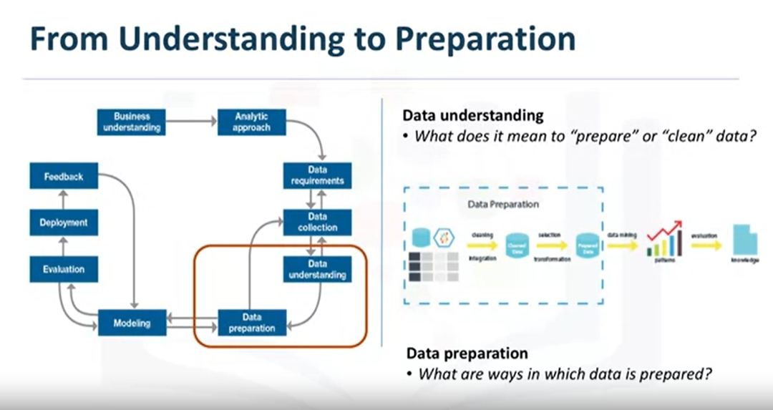
Stage-5

Slide 3
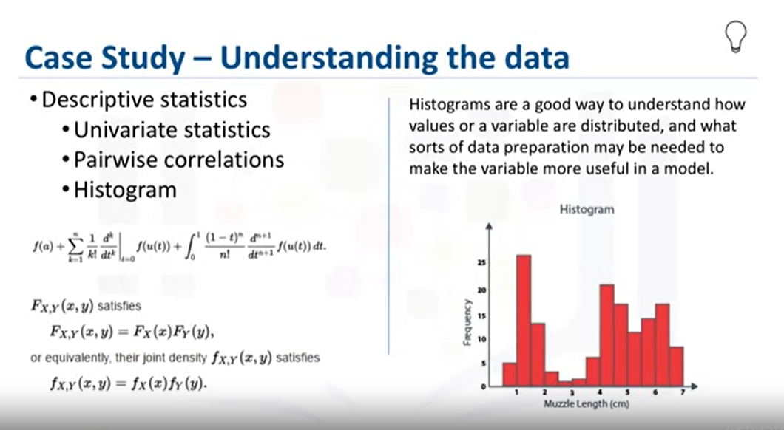

Slide 4
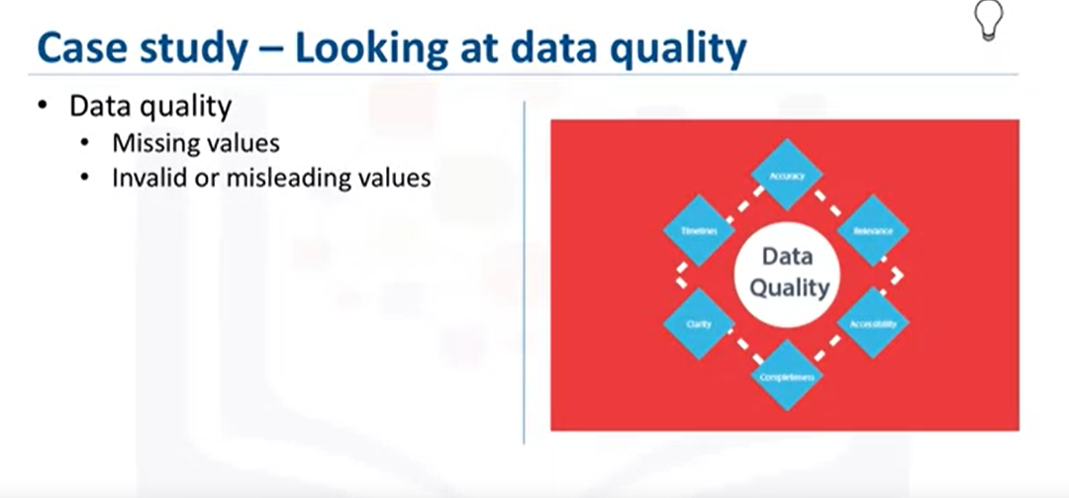
From the information provided, certain values can be re-coded or perhaps even dropped if necessary, such as when a certain variable has many missing values.
The question then becomes, does "missing" mean anything? Sometimes a missing value might mean "no", or "0" (zero), or at other times it simply means "we don't know".
Or, if a variable contains invalid or misleading values, such as a numeric variable called "age" that contains 0 to 100 and also 999, where that "triple-9" actually means "missing", but would be treated as a valid value unless we corrected it.

Slide 5
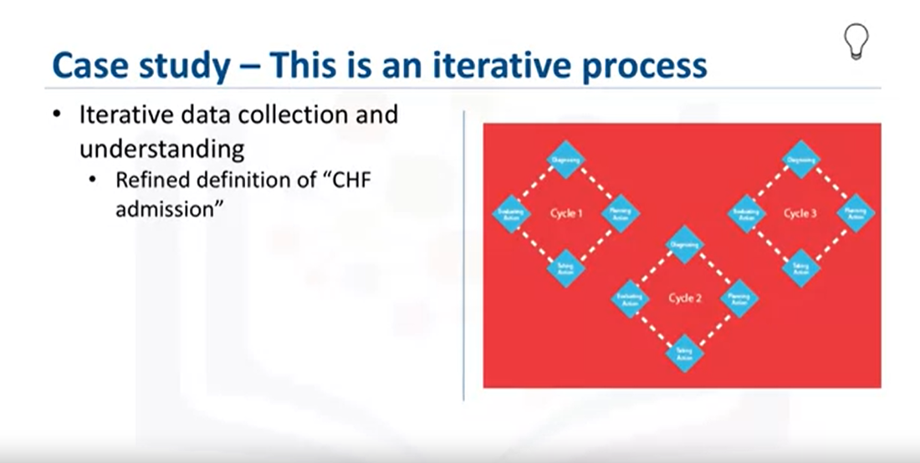

Slide 6

Stage-6
Together with data collection and data understanding, data preparation is the most time-consuming phase of a data science project, typically taking seventy percent and even up to even ninety percent of the overall project time. Automating some of the data collection and preparation processes in the database, can reduce this time to as little as 50 percent. This time savings translates into increased time for data scientists to focus on creating models.

Slide 7
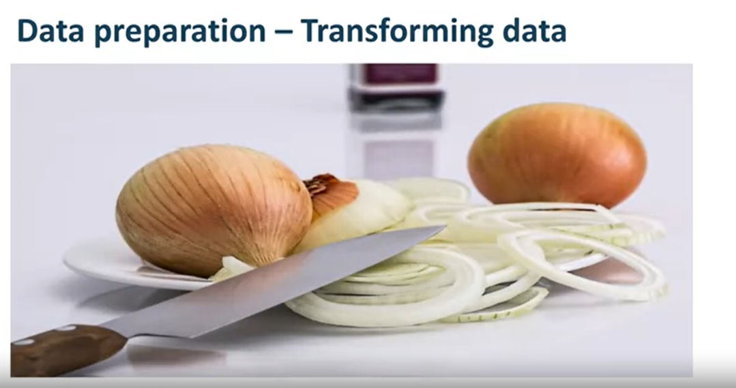
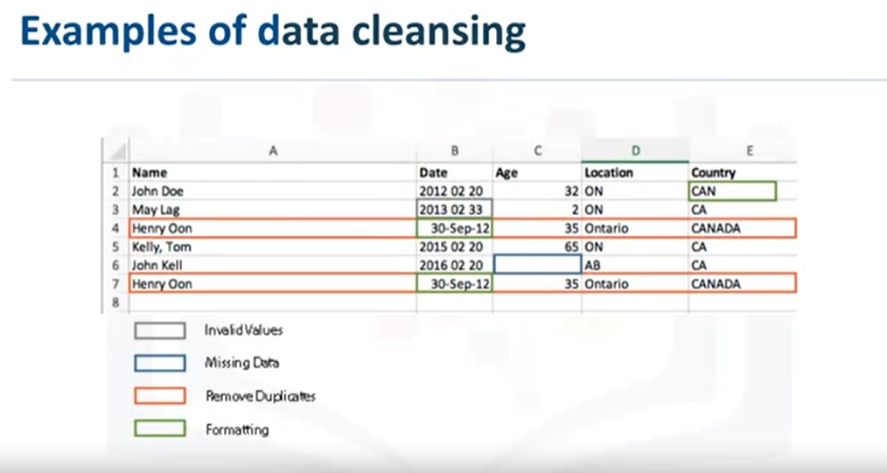

Slide 8
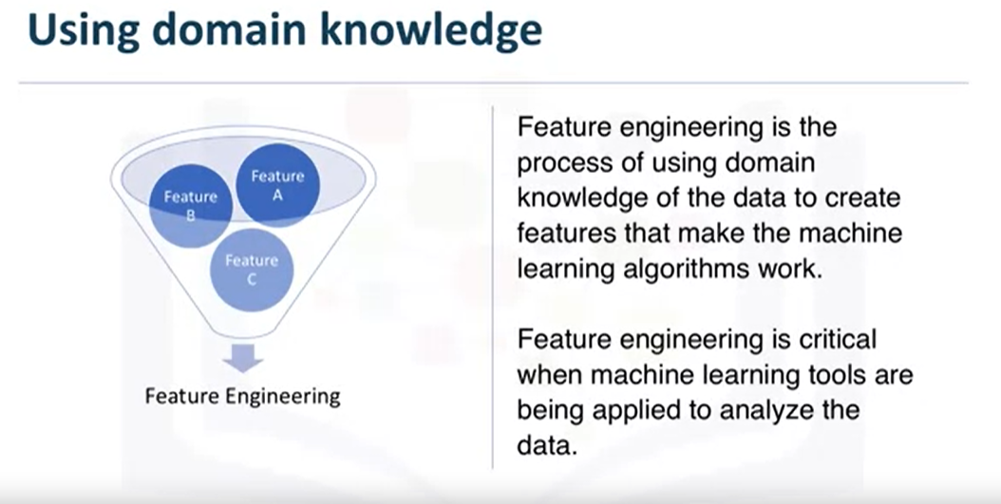

Slide 9
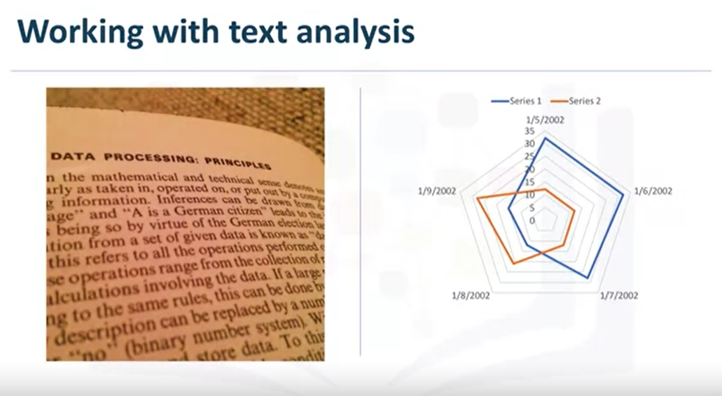
The text analysis is critical to ensure that the proper groupings are set, and that the
programming is not overlooking what is hidden within.
The data preparation phase sets the stage for the next steps in addressing the question. While this phase may take a while to do, if done right the results will support the project. If this is skipped over, then the outcome will not be up to par and may have you back at the drawing board. It is vital to take your time in this area, and use the tools available to automate common steps to accelerate data preparation. Make sure to pay attention to the detail in this area. After all, it takes just one bad ingredient to ruin a fine meal.

Slide 10
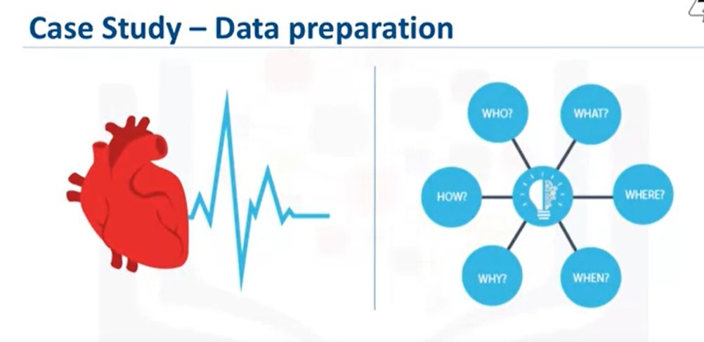
In the case study, an important first step in the data preparation stage was to actually define congestive heart failure.
This sounded easy at first but defining it precisely, was not straightforward.
First, the set of diagnosis-related group codes needed to be identified, as congestive heart failure implies certain kinds of fluid buildup.
We also needed to consider that congestive heart failure is only one type of heart failure. Clinical guidance was needed to get the right codes for congestive heart failure.

Slide 11
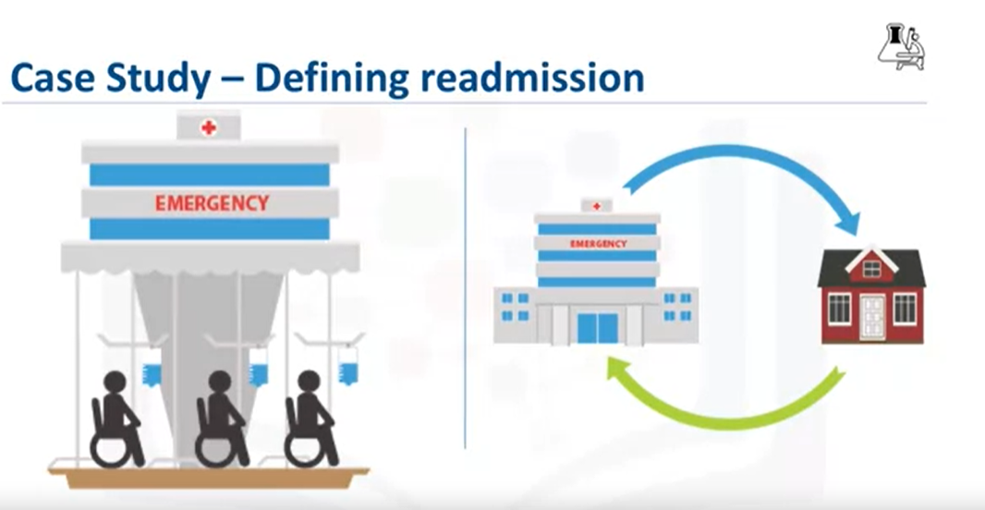
The next step involved defining the re-admission criteria for the same condition.
The timing of events needed to be evaluated in order to define whether a particular congestive heart failure admission was an initial event, which is called an index admission, or a congestive heart failure-related re-admission.
Based on clinical expertise, a time period of 30 days was set as the window for readmission relevant for congestive heart failure patients, following the discharge from the initial admission.

Slide 12
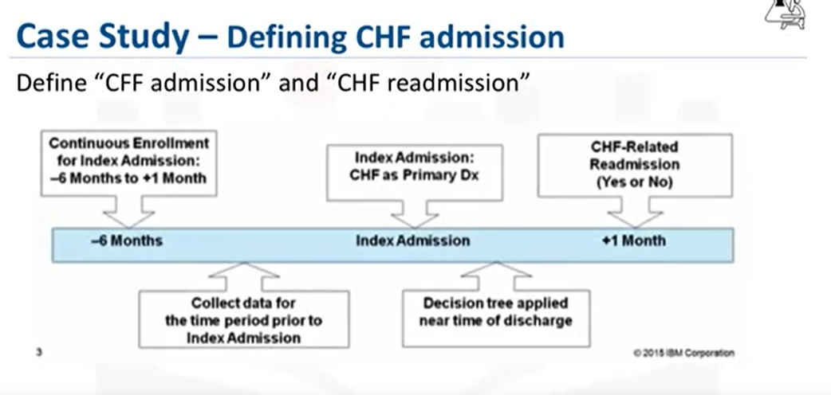
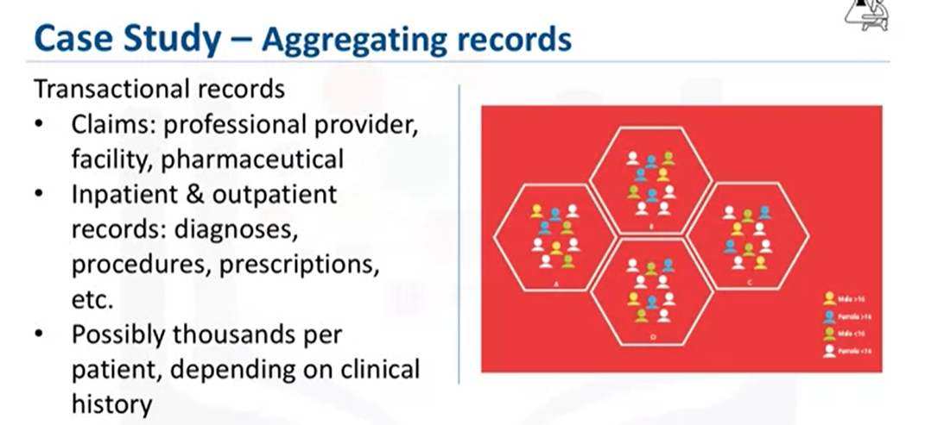

Slide 13
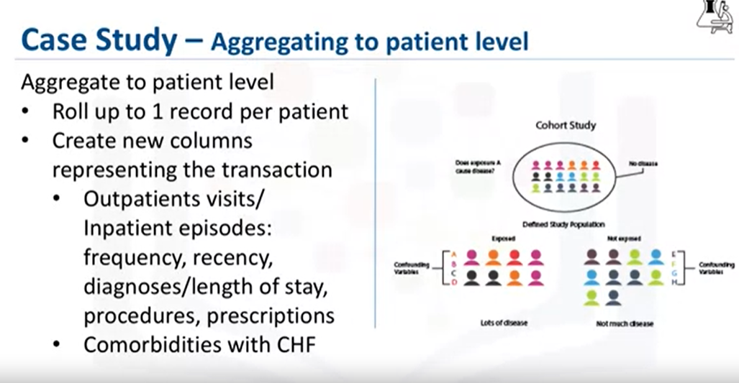

Slide 14
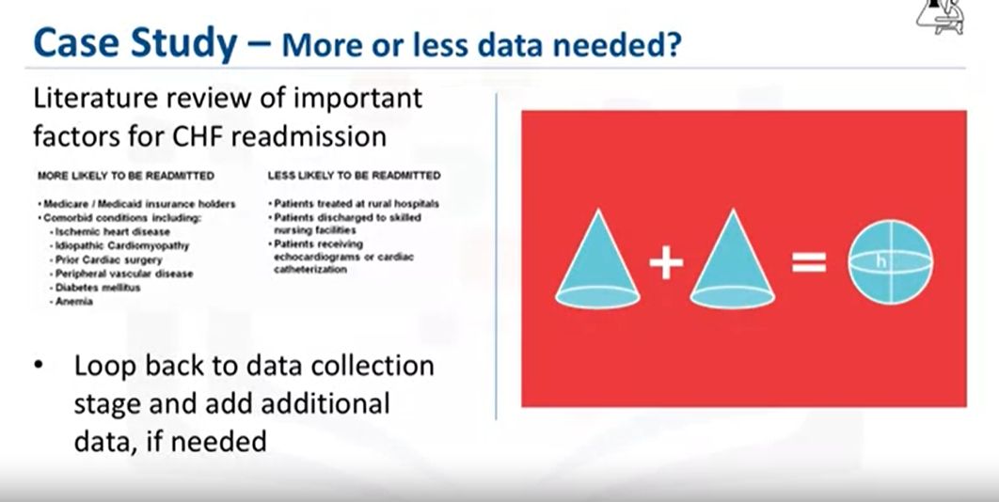

Slide 15
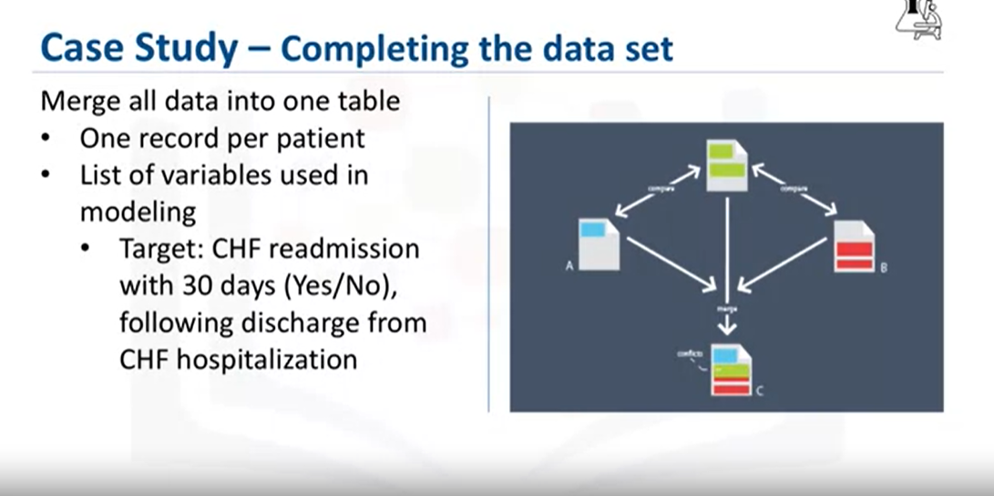
Aggregating the transactional data at the patient level, meant merging it with the other patient data, including their demographic information, such as age, gender, type of insurance, and so forth.
The result was the creation of one table containing a single record per patient, with many columns representing the attributes about the patient in his or her clinical history.
These columns would be used as variables in the predictive modeling.
Here is a list of the variables that were ultimately used in building the model

Slide 16
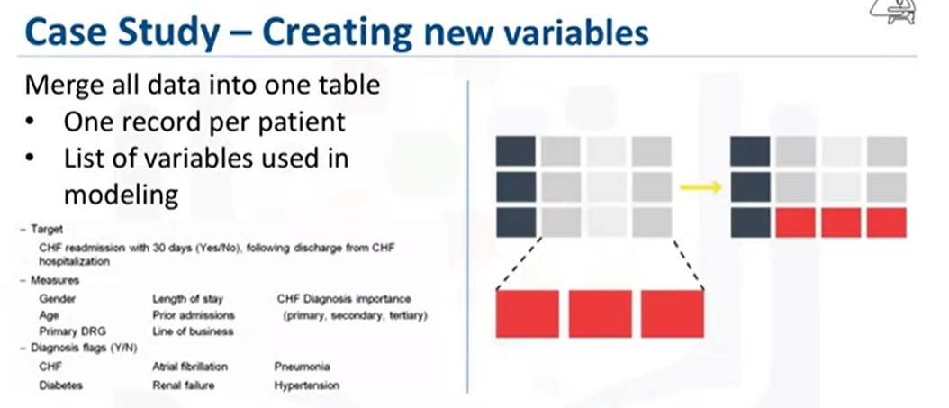
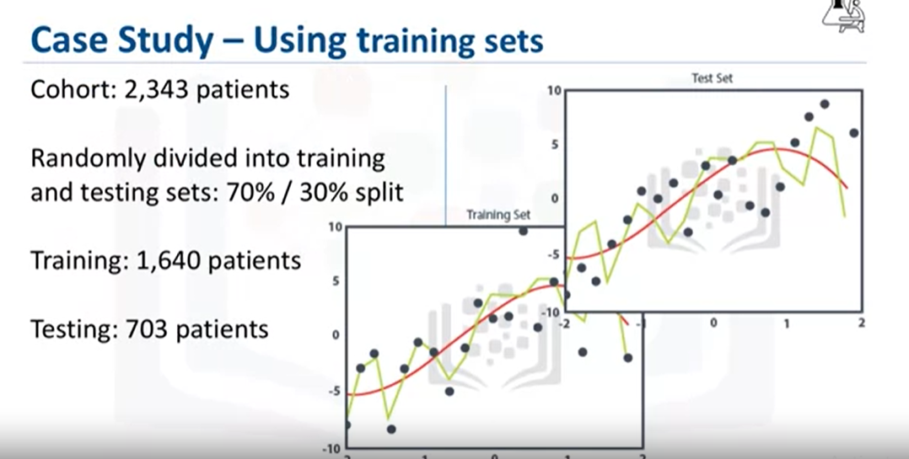

Slide 17
Lesson Summary
The importance of descriptive statistics.
How to manage missing, invalid, or misleading data.
The need to clean data and sometimes transform it.
The consequences of bad data for the model.
Data understanding is iterative; you learn more about your data the more you study it.

Slide 18
Module-2
From Modelling to Evaluation

Slide 19
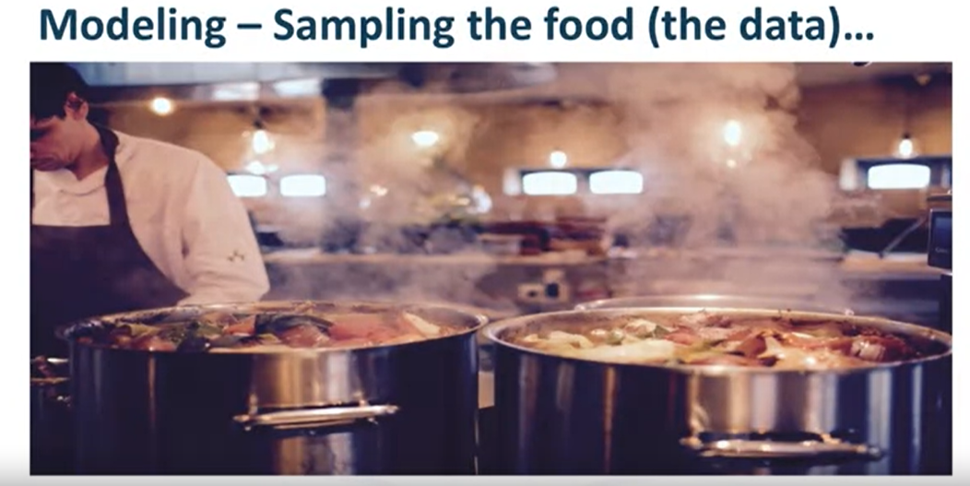
Stage-7

Slide 20
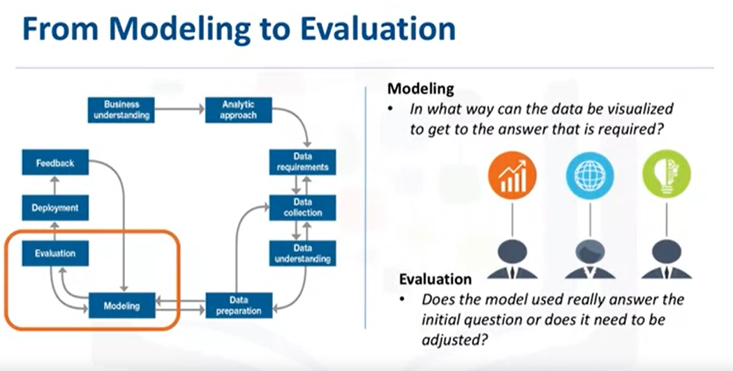
This portion of the course is geared toward answering two key questions:
First, what is the purpose of data modeling, and second, what are some characteristics of this process?
Data Modelling focuses on developing models that are either descriptive or predictive.
An example of a descriptive model might examine things like: if a person did this,
then they're likely to prefer that. A predictive model tries to yield yes/no, or stop/go type outcomes.
These models are based on the analytic approach that was taken, either statistically driven or machine learning driven.

Slide 21
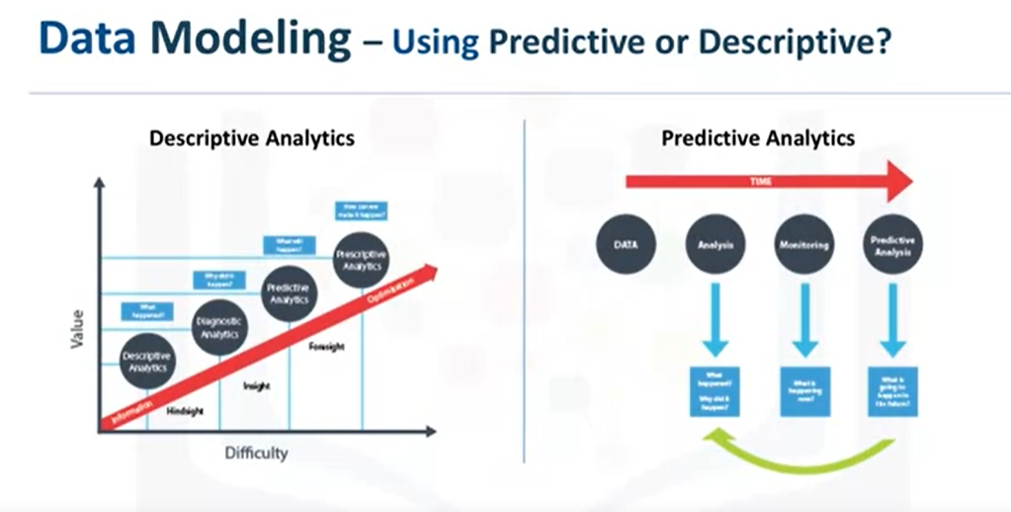
Data Modelling focuses on developing models that are either descriptive or predictive.
An example of a descriptive model might examine things like: if a person did this, then they're likely to prefer that.
A predictive model tries to yield yes/no, or stop/go type outcomes.
These models are based on the analytic approach that was taken, either statistically driven or machine learning driven.
The data scientist will use a training set for predictive modelling.

Slide 22
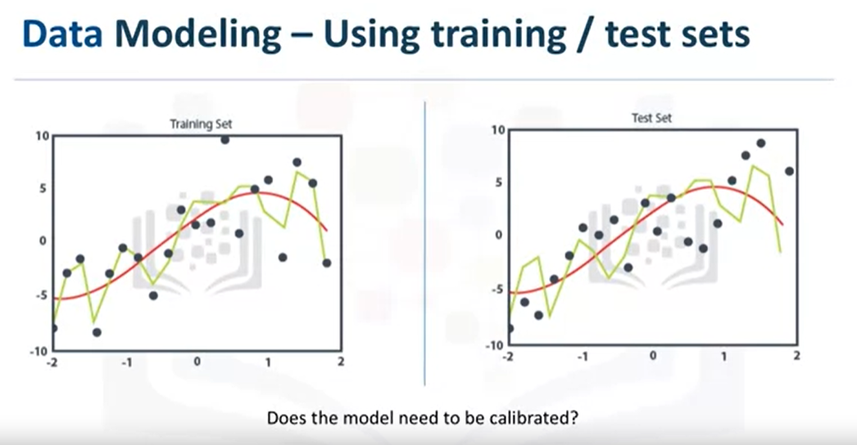
A training set is a set of historical data in which the outcomes are already known.
The training set acts like a gauge to determine if the model needs to be calibrated.
In this stage, the data scientist will play around with different algorithms to ensure that the variables in play are actually required.

Slide 23
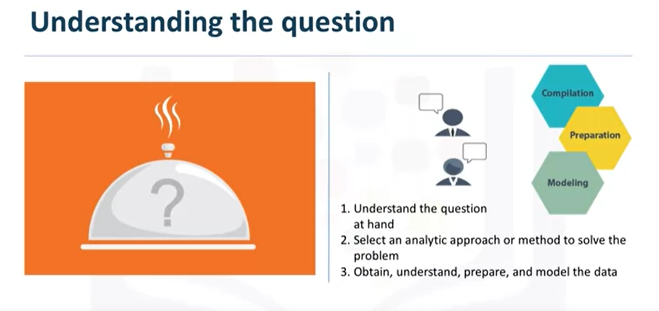
The success of data compilation, preparation and modelling, depends on the understanding of the problem at hand, and the appropriate analytical approach being taken.
The data supports the answering of the question, and like the quality of the ingredients in cooking, sets the stage for the outcome.
Constant refinement, adjustments and tweaking are necessary within each step to ensure the outcome is one that is solid.
In John Rollins' descriptive Data Science Methodology, the framework is geared to do 3 things: First, understand the question at hand. Second, select an analytic approach or method to solve the problem, and third, obtain, understand, prepare, and model the data.
The end goal is to move the data scientist to a point where a data model can be built to answer the question.

Slide 24

Have I made enough to eat? Well, let's hope so.
In this stage of the methodology, model evaluation, deployment, and feedback loops ensure that the answer is near and relevant.
This relevance is critical to the data science field overall, as it ís a fairly new field of study, and we are interested in the possibilities it has to offer.
The more people that benefit from the outcomes of this practice, the further the field will develop.

Slide 25
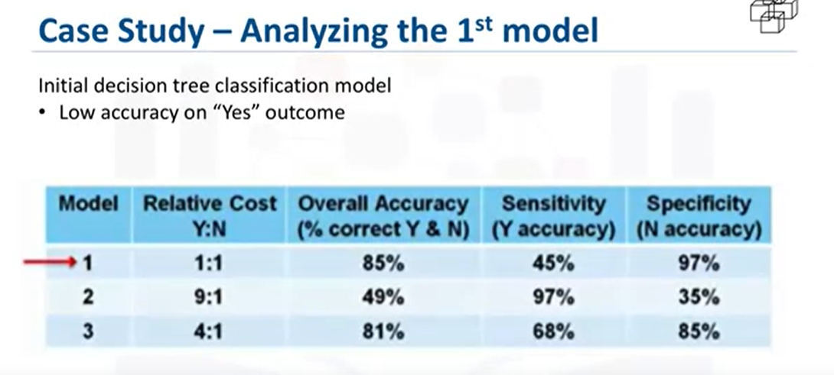
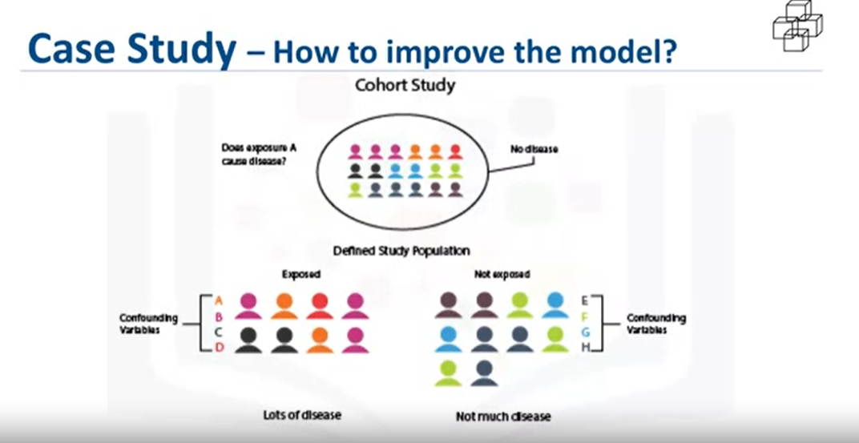

Slide 26
Think of it like this:
When a true, non-readmission is misclassified, and action is taken to reduce that patient's risk, the cost of that error is the wasted intervention. A statistician calls this a type I error, or a false-positive.
But when a true readmission is misclassified, and no action is taken to reduce that risk, then the cost of that error is the readmission and all its attended costs, plus the trauma to the patient. This is a type II error, or a false-negative.
So we can see that the costs of the two different kinds of misclassification errors can be quite different. For this reason, it's reasonable to adjust the relative weights of misclassifying the yes and no outcomes.

Slide 27
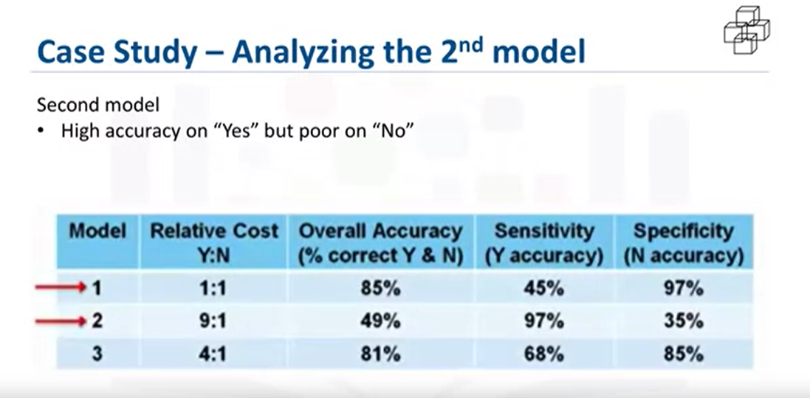
For the second model, the relative cost was set at 9-to-1.
This is a very high ratio, but gives more insight to the model's behaviour.
This time the model correctly classified 97% of the yes, but at the expense of a very low accuracy on the no, with an overall accuracy of only 49%.
This was clearly not a good model.
The problem with this outcome is the large number of false-positives, which would recommend unnecessary and costly intervention for patients, who would not have been re-admitted anyway.

Slide 28
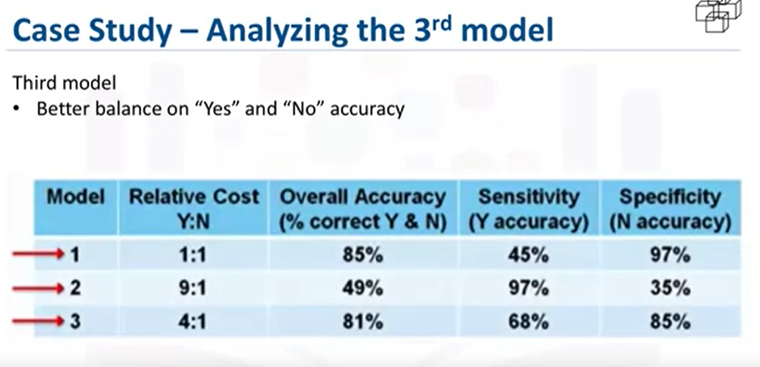
For the third model, the relative cost was set at a more reasonable 4-to-1.
This time 68% accuracy was obtained on only yes, called sensitivity by statisticians, and 85% accuracy on the no, called specificity, with an overall accuracy of 81%.
This is the best balance that can be obtained with a rather small training set through adjusting the relative cost of misclassified yes and no outcomes parameter.
A lot more work goes into the modeling, of course, including iterating back to the data preparation stage to redefine some of the other variables, so as to better represent the underlying information, and thereby improve the model.

Slide 29

Stage-8

Slide 30
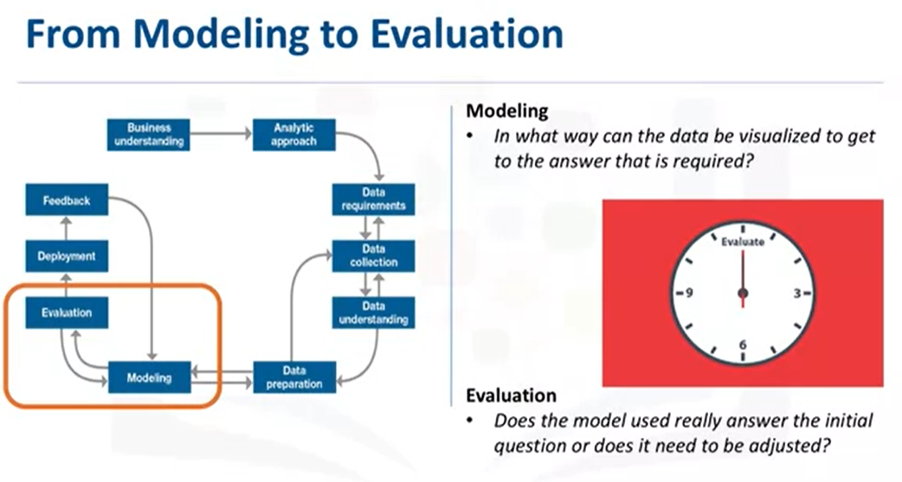
Model evaluation is performed during model development and before the model is deployed.
Evaluation allows the quality of the model to be assessed but it's also an opportunity to see if it meets the initial request.
Evaluation answers the question: Does the model used really answer the initial question or does it need to be adjusted?
Model evaluation can have two main phases.

Slide 31
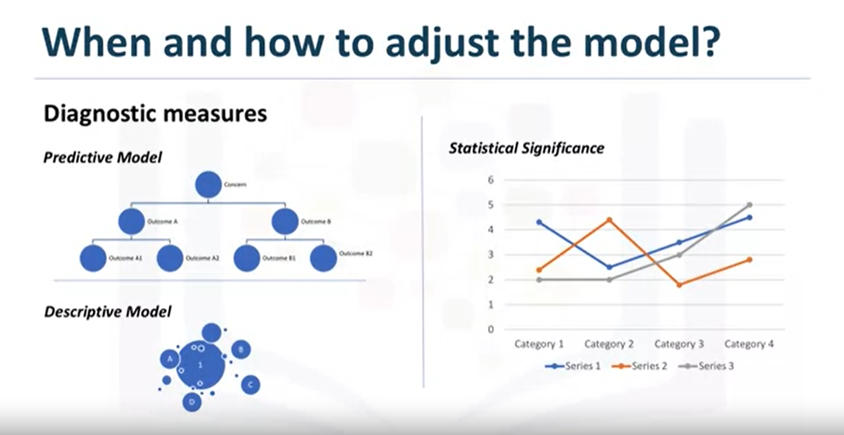
The first is the diagnostic measures phase, which is used to ensure the model is working
as intended. If the model is a predictive model, a decision tree can be used to evaluate if the answer the model can output, is aligned to the initial design. It can be used to see where there are areas that require adjustments.
If the model is a descriptive model, one in which relationships are being assessed, then a testing set with known outcomes can be applied, and the model can be refined as needed.
The second phase of evaluation that may be used is statistical significance testing. This type of evaluation can be applied to the model to ensure that the data is being properly handled and interpreted within the model. This is designed to avoid unnecessary second guessing when the answer is revealed.

Slide 32
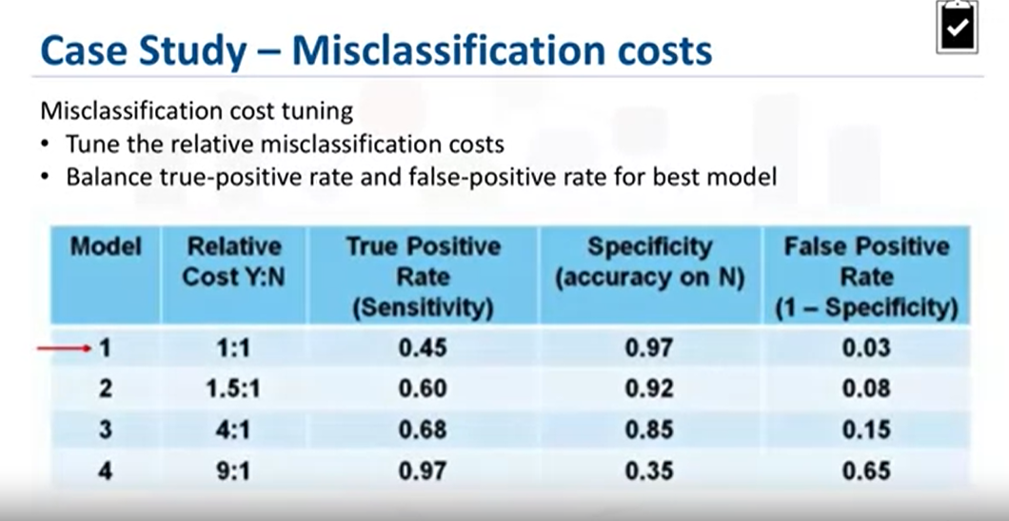
As shown in this table, four models were built with four different relative misclassification
costs. As we see, each value of this model-building parameter increases the true-positive rate, or sensitivity, of the accuracy in predicting yes, at the expense of lower accuracy in predicting no, that is, an increasing false-positive rate.
The question then becomes, which model is best based on tuning this parameter?
For budgetary reasons, the risk-reducing intervention could not be applied to most or all congestive heart failure patients, many of whom would not have been readmitted anyway.
On the other hand, the intervention would not be as effective in improving patient care as it should be, with not enough high-risk congestive heart failure patients targeted.
So, how do we determine which model was optimal?

Slide 33
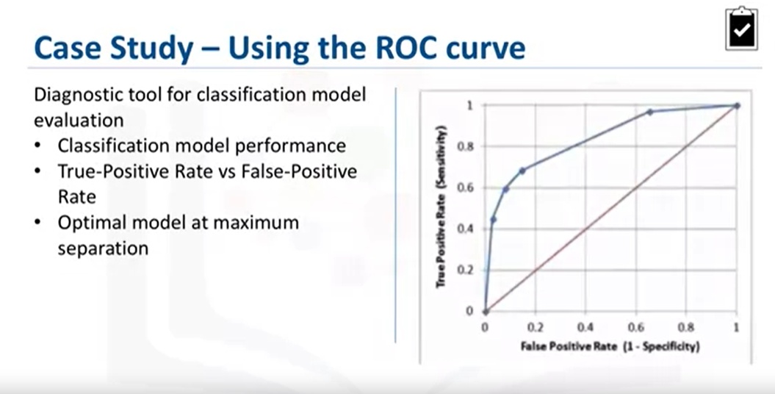
As you can see on this slide, the optimal model is the one giving the maximum separation between the blue ROC curve relative to the red base line. We can see that model 3, with a relative misclassification cost of 4-to-1, is the best of the 4 models.
And just in case you were wondering, ROC stands for receiver operating characteristic curve, which was first developed during World War II to detect enemy aircraft on radar.
It has since been used in many other fields as well. Today it is commonly used in machine learning and data mining. The ROC curve is a useful diagnostic tool in determining the optimal classification model.
This curve quantifies how well a binary classification model performs, declassifying the yes and no outcomes when some discrimination criterion is varied. In this case, the criterion is a relative misclassification cost. By plotting the true-positive rate against the false-positive rate for different values of the relative misclassification cost, the ROC curve helped in selecting the optimal model.

Slide 34
Lesson Summary
The difference between descriptive and predictive models.
The role of training sets and test sets.
The importance of asking if the question has been answered.
Why diagnostic measures tools are needed.
The purpose of statistical significance tests.
That modeling and evaluation are iterative processes.

